Slide 1
IFM Hub and Smart FM – Asset Integration
Notes:
I'm Ellis, a technology expert at CBRE and I’m here to share how our data and technology strategy and capabilities help clients realize maximum potential in their business.

Slide 2
Agenda
Field mapping of assets between Smart FM and IFM Hub
Various approaches for perfect and partial matches of assets from Smart FM to IFM Hub
Parameters and sample data for match approaches
Analysis on the UAT clients - Fifth Third Bank, Hartford, Statefarm and Prod Client - Alaska Airlines
Notes:
I'm Ellis, a technology expert at CBRE and I’m here to share how our data and technology strategy and capabilities help clients realize maximum potential in their business.

Slide 3
Mapping Approaches for Clients – State Farm, Hartford, Fifth Third Bank (UAT)
Notes:
I'm Ellis, a technology expert at CBRE and I’m here to share how our data and technology strategy and capabilities help clients realize maximum potential in their business.

Slide 4
Approaches for Perfect Match Condition
We formulated 3 approaches for a perfect match of assets from Smart FM to IFM Hub data after matching the client
Approach 1
Asset Type/ Position Type
Asset Name
Asset Properties
Make/Manufacturer
Model
Serial
Asset Location
Country
State
City
Region
Approach 2
Asset Type/ Position Type
Asset Name
Asset Location
Country
State
City
Region
Building/Site
Approach 3
Asset Type/ Position Type
Asset Properties
Make/Manufacturer
Model
Serial
Asset Location
Country
State
City
Region
Building/Site

Slide 5
Perfect Match – Approach 1 (no Building/Site in consideration)
Conditions –
The Equipment type in SFM should match perfectly with Position Type in IFM OR
The Equipment Type in SFM is blank/null/ other OR
The Equipment type in SFM matches with Position type in IFM one step up level.
AND
The Nav_Name in SFM matches (90%) with Asset Name in IFM HUB OR
The Nav_Name in SFM matches (90%) with Position Name in IFM Hub OR
The Equipment_Name in SFM matches (90%) with Asset Name in IFM HUB OR
The Equipment_Name in SFM matches (90%) with Position name in IFM Hub
AND
The Equipment_make in SFM matches (95%) with Manufacturer in IFM HUB
AND
The Equipment_Model_Number in SFM matches (95%) with Model in IFM Hub
AND
The Equipment_Serial_Number in SFM matches (100%) with Serial Number in IFM HUB
AND
The combination of Country, State, City in SFM matches (90%) with Region Name in IFM
Approach 1
Asset Type/ Position Type
Asset Name
Asset Properties
Manufacturer
Model
Serial
Asset Location
Country
State
City
Region

Slide 6
Sample Matches on Perfect Match - Approach 1
SFM Asset | IFM Asset
Equipment Type - others | Position Type - D3040.02.06 (Air Handling Unit, Chilled Water, No Heat )
Nav_Name - RENEWAIRE HE2XIN-Energy Recovery Ventilator Equipment_Name - RENEWAIRE HE2XIN-Energy Recovery Ventilator | Position name - RENEWAIRE HE2XIN-Energy Recovery Ventilator Asset Name - Air Handler(RENEWAIRE HE2XIN-Energy Recovery Ventilator)
Equipment_Make - RENEWAIRE | Manufacturer - RENEWAIRE
Equipment_Model_Number - HE2Xin | Model - HE2Xin
Equipment Serial_Number - 71873 | Serial Number - 71873
Country, State, City --- US, CT, Hartford | Region - US, CT, Hartford
Site - 150 Cogswell Street | Building - 150 Cogswell Street
SFM Asset | IFM Asset
Equipment Type - Blank | Position Type – D2090.03.01 (Compressor, Air)
Nav_Name - DC-AGG-AC-DE1-East Equipment_Name - DC-AGG-AC-DE1-East | Position name - (DC-AGG-AC-DE1-East) Asset Name - Air Compressor(DC-AGG-AC-DE1-East)
Equipment_Make - ATLAS COPCO | Manufacturer - ATLAS COPCO
Equipment_Model_Number - (GX4) 8152101237 | Model - GX48152101237
Equipment Serial_Number - CAI325559 | Serial Number - CAI325559
Country, State, City --- US, CT, Hartford | Region - US, CT, Hartford
Site - 1 Hartford Plaza - Data Center | Building - Hartford Data Center
SFM Asset | IFM Asset
Equipment Type - Roof Top Unit | Position Type - D3050.02 (Air Conditioner, Packaged Unit)
Nav_Name – RTU-4 Equipment_Name - RTU-4 | Position name – RTU-4 Asset Name - RTU-4(RTU-4)
Equipment_Make - Trane | Manufacturer - Trane
Equipment_Model_Number - WSC048H3R0A290001 | Model - WSC048H3R0A290001
Equipment Serial_Number - 224114440L | Serial Number - 224114440L
Country, State, City --- US, FL, Naples | Region – US, FL, Naples
Site - FL103682 - 2100 Tamiami Trail N | Building – Naples Garden
SFM Asset | IFM Asset
Equipment Type - CRAC | Position Type - Air Conditioner, Computer Room (D3030.02)
Nav_Name – Computer Room 001 Equipment_Name – Computer Room 001 | Position name – Computer Room 001_CRAC Asset Name - Computer Room 001_CRAC
Equipment_Make - Trane | Manufacturer - Trane
Equipment_Model_Number – TRA0012 | Model – TRA00(12)
Equipment Serial_Number - NXC100123 | Serial Number - NXC100123
Country, State, City --- US, FL, Naples | Region - US, FL, Naples
Site – 3600 Garden Ave, FL | Building – Building 1

Slide 7
Perfect Match – Approach 2 (Building/site in Consideration and Make/Model/Serial not in Consideration)
Conditions –
The Equipment type in SFM should match perfectly with Position Type in IFM
AND
The Nav_Name in SFM matches (90%) with Asset Name in IFM HUB OR
The Nav_Name in SFM matches (90%) with Position Name in IFM Hub OR
The Equipment_Name in SFM matches (90%) with Asset Name in IFM HUB OR
The Equipment_Name in SFM matches (90%) with Position name in IFM Hub
AND
The combination of Country, State, City in SFM matches (90%) with Region Name in IFM
AND
The Site name in SFM matches (75%) with Building Name in IFM Hub
Approach 2
Asset Type/ Position Type
Asset Name
Asset Location
Country
State
City
Region
Building/Site

Slide 8
Sample Matches on Perfect Match - Approach 2
SFM Asset | IFM Asset
Equipment Type – Fan Coil Unit | Position Type - Fan Coil Unit (D3050.03)
Nav_Name – FCU_Daikin_Upstairs Equipment_Name – Computer Room 001 | Position name – FCU_Daikin_Upstairs12 Asset Name - FCU_Daikin_Upstairs12_1
Equipment_Make - Daikin | Manufacturer – Daikin Inc
Equipment_Model_Number – Unknown | Model – DAI Fan Coil
Equipment Serial_Number - Null | Serial Number - DAIFCU9001
Country, State, City --- US, FL, Naples | Region - US, FL, Naples
Site – 301 Woods Park Dr | Building – Woods Park Ave 301, FL
SFM Asset | IFM Asset
Equipment Type - Heater | Position Type - Heater (D3020.09)
Nav_Name – Heater unit Top Floor Equipment_Name – Heater unit Top Floor | Position name – Heater unit 001_Top Floor Asset Name - Heater unit Top Floor (Heater)
Equipment_Make - Unk | Manufacturer – Daikin
Equipment_Model_Number – Daikin0NBCv1 | Model – DNBCv1
Equipment Serial_Number - Unknown | Serial Number – 0001Heater
Country, State, City --- US, NY, New York City | Region - US, NY, New York City
Site – 1 Griffin Rd N | Building – Griffen Road

Slide 9
Perfect Match – Approach 3 (Asset Name not in Consideration)
Approach 3
Asset Type/ Position Type
Asset Properties
Manufacturer
Model
Serial
Asset Location
Country
State
City
Region
Building/Site
Conditions –
The Equipment type in SFM should match perfectly with Position Type in IFM OR
The Equipment Type in SFM is blank/null/ other OR
The Equipment type in SFM matches with Position type in IFM one step up level.
AND
The Equipment_make in SFM matches (95%) with Manufacturer in IFM HUB
AND
The Equipment_Model_Number in SFM matches (95%) with Model in IFM Hub
AND
The Equipment_Serial_Number in SFM matches (100%) with Serial Number in IFM HUB
AND
The combination of Country, State, City in SFM matches (90%) with Region Name in IFM
AND
The Site name in SFM matches (75%) with Building Name in IFM Hub

Slide 10
Sample Matches on Perfect Match – Approach 3
SFM Asset | IFM Asset
Equipment Type – Evaporator | Position Type - Evaporator (D3030.09)
Nav_Name – Evaporator_Basement room_Unit1 Equipment_Name – Evaporator_Basement room_Unit1 | Position name – EVP_Base_Building Asset Name - EVP_Base
Equipment_Make - Trane | Manufacturer – Trane
Equipment_Model_Number – TRNVZCQW | Model – TRNVZCQW
Equipment Serial_Number - BZ123NBZ1 | Serial Number - BZ123NBZ1
Country, State, City --- US, NC, Charlotte | Region - US, NC, Charlotte
Site – 4000 Hollywood Boulevard | Building – Hollywood Boulevard
SFM Asset | IFM Asset
Equipment Type - Null | Position Type - Air Handling Unit (D3040.02)
Nav_Name – AHU_01 Equipment_Name – AHU_01 | Position name – Air Handling Unit_01_Top Room Asset Name - Air Handling Unit_01
Equipment_Make - Daikin | Manufacturer - Daikin
Equipment_Model_Number – NADS133 | Model – NADS133
Equipment Serial_Number -ZXC1245ADSA | Serial Number - ZXC1245ADSA
Country, State, City --- US, TX, Dallas | Region - US, TX, Dallas
Site – 300, Trailwood Dr | Building – Traildwood Dr Data Center

Slide 11
Approaches for Partial Match Condition
We formulated 2 approaches for a perfect match of assets from Smart FM to IFM Hub data after matching the client
Approach 1
Asset Type/ Position Type
Asset Name
Asset Location
Country
State
City
Region
Building/ Site
Approach 2
Asset Type/ Position Type
Asset Name
Asset Properties
Make/Manufacturer
Model
Serial
Asset Location
Country
State
City
Region
Building/Site

Slide 12
Partial Match – Approach 1 (Building in Consideration)
Conditions –
The Equipment type in SFM should match perfectly with Position Type in IFM
AND
The Nav_Name in SFM matches (50%) with Asset Name in IFM HUB OR
The Nav_Name in SFM matches (50%) with Position Name in IFM Hub OR
The Equipment_Name in SFM matches (50%) with Asset Name in IFM HUB OR
The Equipment_Name in SFM matches (50%) with Position name in IFM Hub
AND
The combination of Country, State, City in SFM matches (90%) with Region Name in IFM
AND
The Site name in SFM matches (50%) with Building Name in IFM Hub
Approach 1
Asset Type/ Position Type
Asset Name
Asset Location
Country
State
City
Region
Building/ Site

Slide 13
Sample Matches on Partial Match - Approach 1
SFM Asset | IFM Asset
Equipment Type – Cooling Tower | Position Type - Cooling Tower (D3030.06)
Nav_Name – Tower 01, Cooling Unit Room Equipment_Name – Tower 01, Cooling Unit Room | Position name – CT, Cooling Tower Asset Name - CT, Cooling Tower 001
Equipment_Make - Unk | Manufacturer – Unknown
Equipment_Model_Number – 00001 | Model – ZVBQQ
Equipment Serial_Number - | Serial Number - ABVZQEE
Country, State, City --- US, TX, Houston | Region - US, TX, Houston
Site – 1900 North St., TX | Building – 1900 TX
SFM Asset | IFM Asset
Equipment Type – Heat Pump | Position Type - Air Conditioner, Heat Pump (D3050.01)
Nav_Name – Heat Pump Unit 1 Equipment_Name – Heat Pump Unit 1 | Position name – Unit 1 Asset Name – Unit 1Pump
Equipment_Make - 0000 | Manufacturer – Daikin
Equipment_Model_Number – Unk | Model – NZVVAQ
Equipment Serial_Number - | Serial Number – ABX123ZZ
Country, State, City --- US, NY, Clinton | Region - US, NY, Clinton
Site – 3655 North Point Parkway | Building – 3655 North PP

Slide 14
Partial Match – Approach 2 (All parameters in consideration)
Conditions –
The Equipment type in SFM should match perfectly with Position Type in IFM OR
The Equipment Type in SFM is blank/null/ other OR
The Equipment type in SFM matches with Position type in IFM one step up level.
AND
The Nav_Name in SFM matches (50%) with Asset Name in IFM HUB OR
The Nav_Name in SFM matches (50%) with Position Name in IFM Hub OR
The Equipment_Name in SFM matches (50%) with Asset Name in IFM HUB OR
The Equipment_Name in SFM matches (50%) with Position name in IFM Hub
AND
The Equipment_make in SFM matches (50%) with Manufacturer in IFM HUB
AND
The Equipment_Model_Number in SFM matches (50%) with Model in IFM Hub
AND
The Equipment_Serial_Number in SFM matches (50%) with Serial Number in IFM HUB
AND
The combination of Country, State, City in SFM matches (90%) with Region Name in IFM
AND
The Site name in SFM matches (50%) with Building Name in IFM Hub
Approach 2
Asset Type/ Position Type
Asset Name
Asset Properties
Manufacturer
Model
Serial
Asset Location
Country
State
City
Region
Building/Site

Slide 15
Sample Matches on Partial Match - Approach 2
SFM Asset | IFM Asset
Equipment Type – Make Up Air Unit | Position Type - Make-Up Air Unit (D3040.02.14)
Nav_Name – MUAU Unit 01 Equipment_Name – MUAU Unit 01 | Position name – Make up Unit 01 Asset Name – Make up air unit
Equipment_Make – Trane Inc | Manufacturer – Trane
Equipment_Model_Number – BZNANAF | Model – BZNAN109
Equipment Serial_Number -109NBX | Serial Number – 109NBZNBX
Country, State, City --- US, TN, Franklin | Region --- US, TN, Franklin
Site – 300 South State Street | Building – 300 SS Street
SFM Asset | IFM Asset
Equipment Type - Other | Position Type - Heater (D3020.09)
Nav_Name – Heater in Roof Unit Equipment_Name – Heater in Roof Unit | Position name – Heater Asset Name - Heater
Equipment_Make –Daikin Inc | Manufacturer – Daikin
Equipment_Model_Number – NBZCAA122 | Model – NBZC
Equipment Serial_Number -JASSGTQ12 | Serial Number – JASSGTQ
Country, State, City --- US, CT, Windsor | Region - US, CT, Windsor
Site – 301 Woods Park Dr | Building – Woods Pk Dr

Slide 16
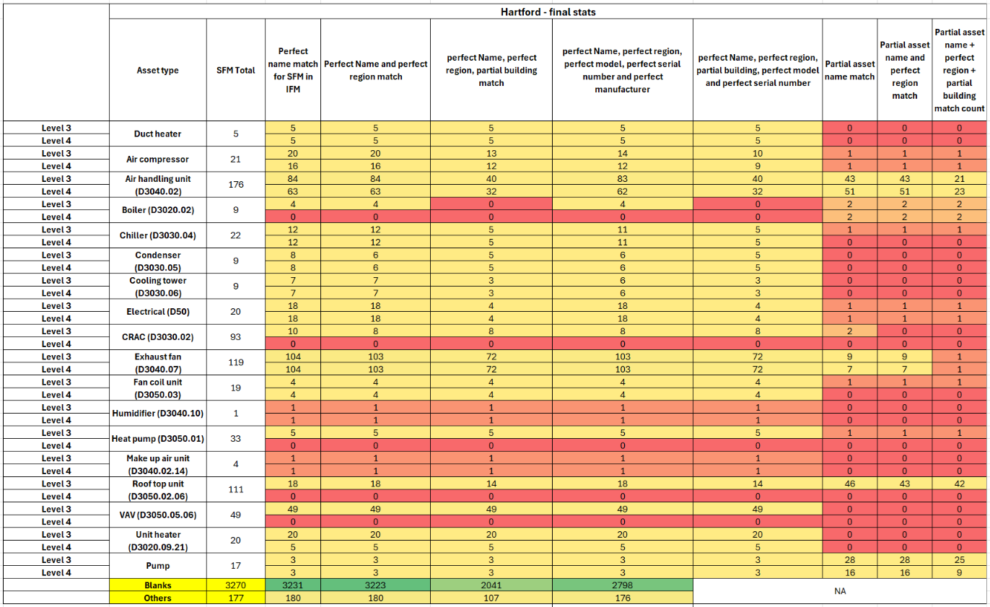
Analysis on Perfect Match – Approach 1
Client - Hartford

Slide 17
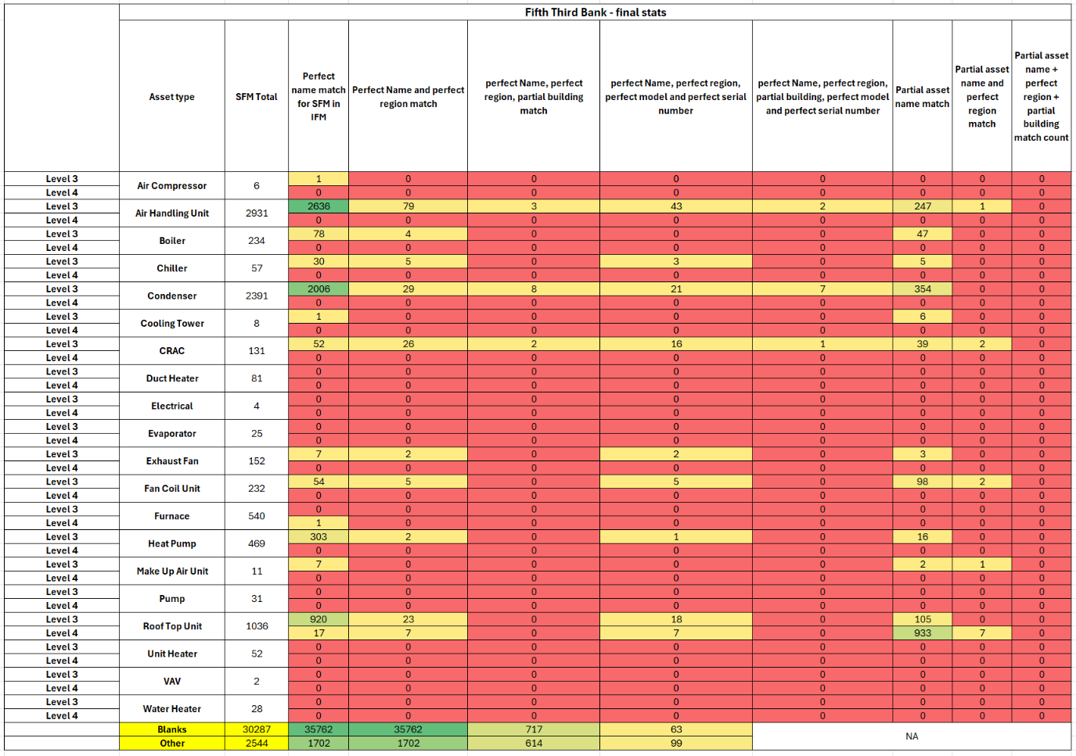
Analysis on Perfect Match – Approach 1
Client – Fifth Third Bank

Slide 18
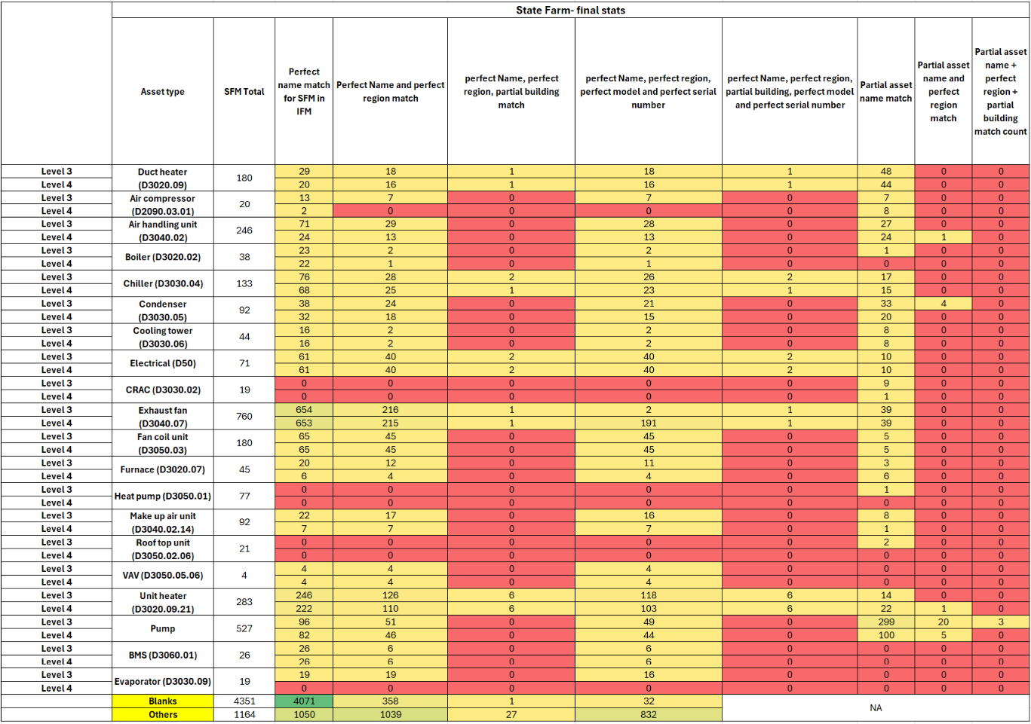
Analysis on Perfect Match – Approach 1
Client – State Farm

Slide 19
Percentage match on 3 clients – UAT Data
 | Hartford | Fifth Third Bank | State Farm
perfect type, name, region, manufacturer, serial and model number match (Perfect Match Approach 1) | 79.62% | 0.65% | 15.19%
perfect type, perfect name and region match | 90.08% | 91.24% | 24.34%

Slide 20
Appendix
Field Mapping of SFM and IFM – Hartford, State Farm, Fifth Third Bank
SFM Field | Sample Data | IFM Field | Sample Data
Nav_Name | Qty: 1 ** ANZ-2006218|AHU|1 Number||(Air Handlers-Air Handling Unit, Chilled Water, Electric Heat, < 15,000 cfm) | Asset Name | Condenser, Air Cooled(AGA-FSFZ-PK418-North Building Southeast Tunnel-AGA-SUB-NBLDSETUN)
 |  | Position Name | AGA-FSFZ-PK418-North Building Southeast Tunnel-AGA-SUB-NBLDSETUN
Equipment_Name | Qty: 2 ** ANZ-2005411|Supply Air System Large 23m3/s|2 Number||(Air Handlers-Fan, Supply, Axial/Centrifugal) | Asset Name | Condenser, Air Cooled(AGA-FSFZ-PK418-North Building Southeast Tunnel-AGA-SUB-NBLDSETUN)
 |  | Position Name | AGA-FSFZ-PK418-North Building Southeast Tunnel-AGA-SUB-NBLDSETUN
Equipment_Serial_Number | 42400715 4210091 | Serial_number | 96687591 JB16279576
Equipment_Model_Number | FTXS100KAVMA FC62D3xN1A | model | C3AL-0153TAC-001 75T803BN
Equipment_Make | Daikin Coleman | Manufacturer | COPELAND LIEBERT
Asset Type | Fan Coil Unit Air Handling Unit | Position type | Services D / HVAC D30 / Terminal & Package Units D3050 / Air Conditioner, Packaged Unit D3050.02 / Air Conditioner, DX Packaged, Air-Cooled D3050.02.01
ml_Reasoning | The equipment description contains the key phrase "AHU" and explicitly mentions "Air Handling Unit" in the context of a centralized system. According to the knowledge bank, "AHU" is a key phrase that corresponds to the "Air Handling Unit" asset category. Additionally, the description specifies characteristics typical of an air handling unit, such as "Chilled Water" and "Electric Heat," which further supports this classification. Therefore, based on the presence of the key phrase and the detailed description, I have classified this equipment as an Air Handling Unit. | Asset Details | WAL: Walls PDS: Power Distribution System
 |  | Asset Notes | CRITICALITY: 0-Non-Critical CRITICALITY: 1-Very High
Country | Abbr of country, eg US, IN etc | Region Name | US, TX, Houston US, CT, Hartford
State | Abbr of State eg TX, IL, Nj etc
City | Full City name – Dallas, Houston etc
Site | Unit 1, 34 Grant Road Cnr Cuba & Rangitikei Sts | Building Name | 301 Woods Park Drive Data Center Headquarters

Slide 21
Mapping Approaches for Client – Alaska Airlines (Prod)
Notes:
I'm Ellis, a technology expert at CBRE and I’m here to share how our data and technology strategy and capabilities help clients realize maximum potential in their business.

Slide 22
Approach for Perfect Match Condition
Approach 1
Asset Type/ Position Type
Asset Name
Asset Location
Country
State
City
Region
Building/ SIte
Conditions –
The Equipment type in SFM should match perfectly with Position Type in IFM OR
The Equipment Type in SFM is Blank/ Other/ Null OR
The Equipment Type in SFM matches with Position Type in IFM one step up level OR
The Position Type in IFM Hub is undefined (E1090.06, E1090.06.01) OR
The Equipment Type in SFM matched (90%) to the equipment part description in IFM
AND
The nav_type (equip)-> nav_name in SFM matches (80%) with Position Name in IFM HUB OR
The nav_type (equip)-> nav_name in SFM matches (80%) with Asset Name in IFM HUB
AND
The combination of Country, State, City in SFM matches (90%) with Region Name in IFM
AND
The Site name in SFM matches (80%) with Building Name in IFM Hub

Slide 23
Sample Matches on Perfect Match
SFM Asset | IFM Asset
Equip Type – vav | Position Type - Terminal Unit, VAV
Nav Type (Equip) -> Nav Name – VAV 0001 | Position name – VAV-01-01
Country, State, City --- US, WA, Seatac | Region --- US, WA, SEA
Site - Alaska Airlines Corporate HQ | Building – CHQ
SFM Asset | IFM Asset
Equip Type – ahu | Position Type - Air Handling Unit
Nav Type (Equip) -> Nav Name – AHU 02 | Position name – AHU-R02
Country, State, City --- US, WA, Seatac​ | Region --- US, WA, SEA
Site - Copper River (The Hub) | Building – Hub 1 or Hub Garage

Slide 24
Approach for Partial Match Condition
Approach
Asset Type/ Position Type
Asset Name
Asset Location
Country
State
City
Region
Building/Site
Conditions –
The Equipment type in SFM should match perfectly with Position Type in IFM OR
The Equipment Type in SFM is Blank/ Other/ Null OR
The Equipment Type in SFM matches with Position Type in IFM one step up level OR
The Position Type in IFM Hub is undefined (E1090.06, E1090.06.01) OR
The Equipment Type in SFM matched (90%) to the equipment part description in IFM
AND
The nav_type (equip)-> nave_name in SFM matches (50%) with Position Name in IFM HUB OR
The nav_type (equip)-> nave_name in SFM matches (50%) with Asset Name in IFM HUB
AND
The combination of Country, State, City in SFM matches (90%) with Region Name in IFM
AND
The Site name in SFM matches (50%) with Building Name in IFM Hub

Slide 25
Sample Matches on Partial Match
SFM Asset | IFM Asset
Equip Type – ahu | Position Type – Air Handling Unit
Nav Type (Equip) -> Nav Name – AHU 01 | Position name – AHU-1-F1 or AHU-1-F2
Country, State, City --- US, WA, Seatac | Region --- US, WA, SEA
Site - Alaska Airlines Corporate HQ | Building – CHQ
SFM Asset | IFM Asset
Equip Type – vav | Position Type - Terminal Unit, VAV
Nav Type (Equip) -> Nav Name – VAV 0001 | Position name – VAV-01-01 or VAV-01-02
Country, State, City --- US, WA, Seatac​ | Region --- US, WA, SEA
Site - GO | Building – GO

Slide 26
Percentage match on Alaska Airlines – Prod Data
Match Approach | Percentage
Perfect Match Approach | 31.69%
Partial Match Approach | 41.26%

Slide 27
Appendix
Field Mapping of SFM and IFM – Alaska Airlines (Prod Data)
SFM Field | Sample Data | IFM Field | Sample Data
Nav_type (project) -> nav_name | Alaska Airlines | Customer_name | Alaska Airlines
Nav_type (country) -> nav_name | United States | Country_name Region_Name | United States US. TX, Dallas (combinaltion of Country Abbr, State Abbr and City)
Nav_type (State) -> nav_name | WA
Nav_type (City) -> nav_name | Seatac
Nav_type (Site) -> nav_name | Alaska Airlines Corporate HQ Alaska Airlines GO | Building_Name | Bell Road East, Winter Haven OC
Nav_type (floor) -> nav_name | All | Floor_Name | Tunnel, Exterior
Nav_type (Area) -> nav_name | All | Room_Name | Conference Room, Meeting Room
Nav_type (Equip)-> nav_name | FCU 0102 Discharge Fan VAV F20236 | Position Name | Discharge Fan Packaged Terminal Air Conditioner(RTU-04)
Equip_Type | Ahu, fcu | Position_uniformat_code | D3040.02.06 D3040.03.07
 |  | Position_type_description | Services D / HVAC D30 / Distribution Systems D3040 / Air Handling Unit D3040.02 / Air Handling Unit, Chilled Water, No Heat D3040.02.06 Services D / HVAC D30 / Distribution Systems D3040 / Fan D3040.07 / Fan, Exhaust, Small (Single-Phase Motor) D3040.07.10

